Slide 1



AGRIBOT
AN INTELLIGENT CHATBOT FOR FARMERS
WITH CROP AND DISEASE PREDICTION

Slide 2
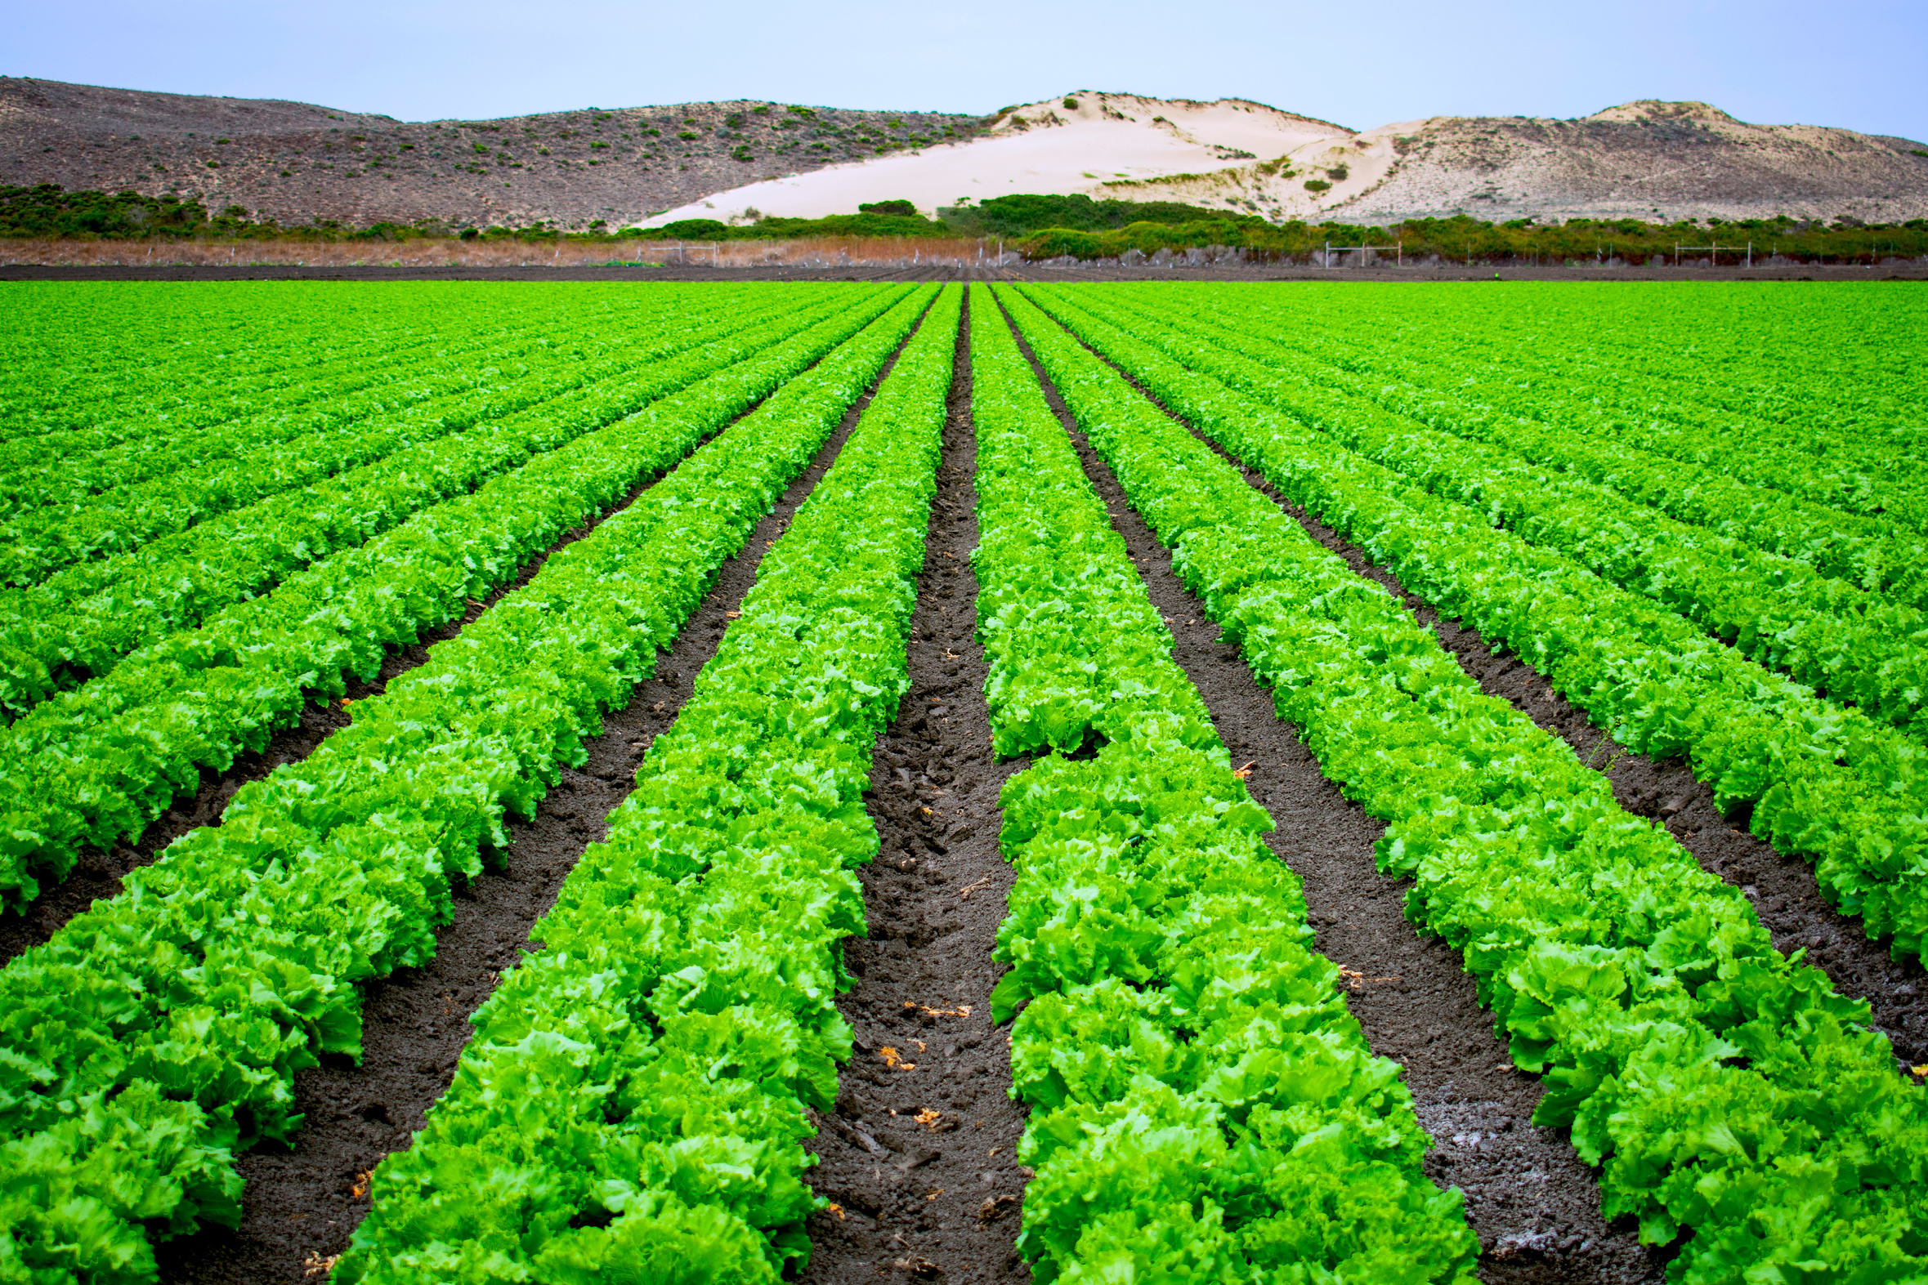

ABSTRACT
  This project aims to develop an AI-powered chatbot designed to assist farmers by providing real-time answers to agricultural queries, recommending crops based on soil parameters, and predicting crop diseases using image analysis.
  The chatbot will integrate machine learning algorithms and natural language processing to enable seamless communication between farmers and the system.
  Additionally, by leveraging soil data, the chatbot will offer personalized crop recommendations tailored to the specific conditions of the farmer’s land.
  The image-based disease prediction module will allow farmers to upload pictures of affected plants, and the system will analyze the images to provide accurate diagnoses and treatment suggestions.
  This tool aims to empower farmers with actionable insights, improving their decision-making process and contributing to sustainable agriculture.

Slide 3





GOALS AND OBJECTIVES
Objective n° 1
Objective n° 2
Objective n° 3
Provide Instant Agricultural Support: Develop an AI-driven chatbot capable of answering a wide range of queries
Personalized Crop Recommendations: Implement a system that recommends the most suitable crops based on real-time analysis of soil parameters
Disease Prediction via Image Analysis: Create a machine learning-based image recognition tool that can accurately predict plant diseases

Slide 4


INTRODUCTION
  Agriculture is the backbone of many economies, yet farmers continue to face challenges in optimizing crop yields, managing soil health, and controlling plant diseases.
  With the increasing need for sustainable farming practices and access to timely, accurate information, integrating technology into agriculture has become essential.
  This project presents an AI-powered chatbot designed to assist farmers by addressing common agricultural challenges through an easy-to-use platform.
  The chatbot not only answers farmers' queries but also provides personalized crop recommendations based on soil parameters and predicts plant diseases through image analysis.
  By combining machine learning, natural language processing, and image recognition technologies, this system aims to enhance decision-making, improve productivity, and promote sustainable farming practices.

Slide 5

EXISTING
SYSTEM

Slide 6

EXISTING SYSTEM
  In modern agriculture, farmers often struggle with optimizing crop production, managing soil health, and diagnosing plant diseases.
  To address these challenges, the integration of advanced machine learning techniques can play a crucial role in supporting farmers with real-time, data-driven insights.
80%
  This project introduces an AI-powered chatbot designed specifically for agriculture, utilizing the Support Vector Machine (SVM) algorithm to recommend suitable crops based on soil parameters and predict plant diseases from images.
ACCURACY

Slide 7
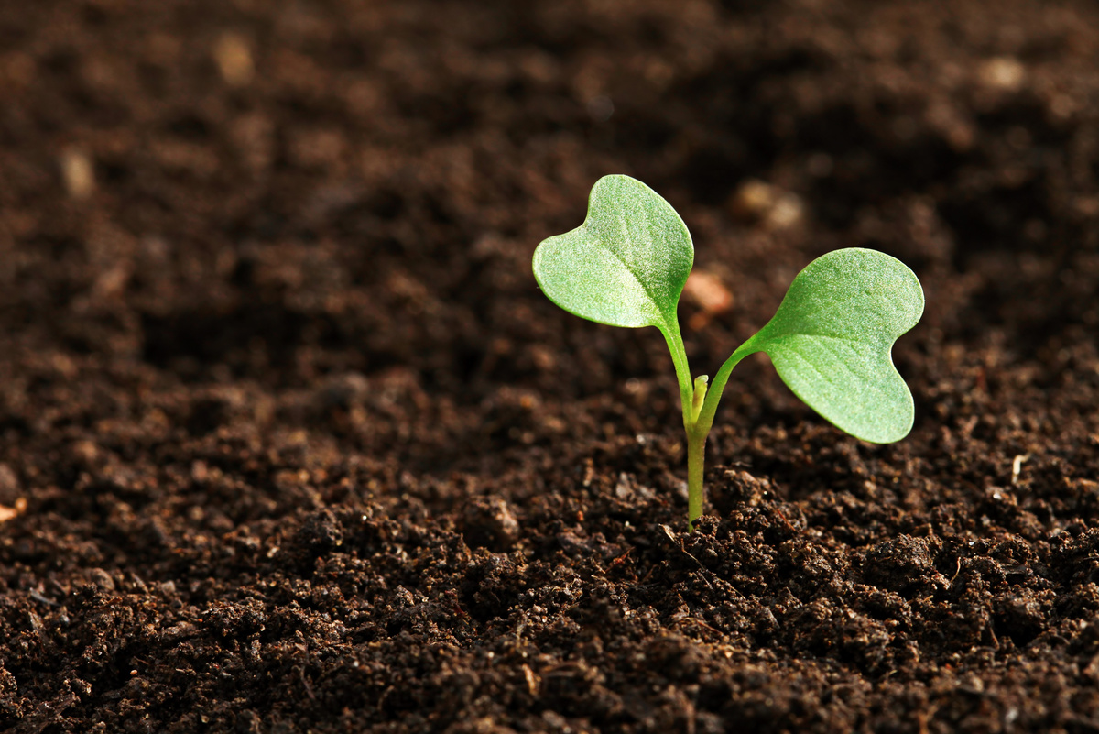
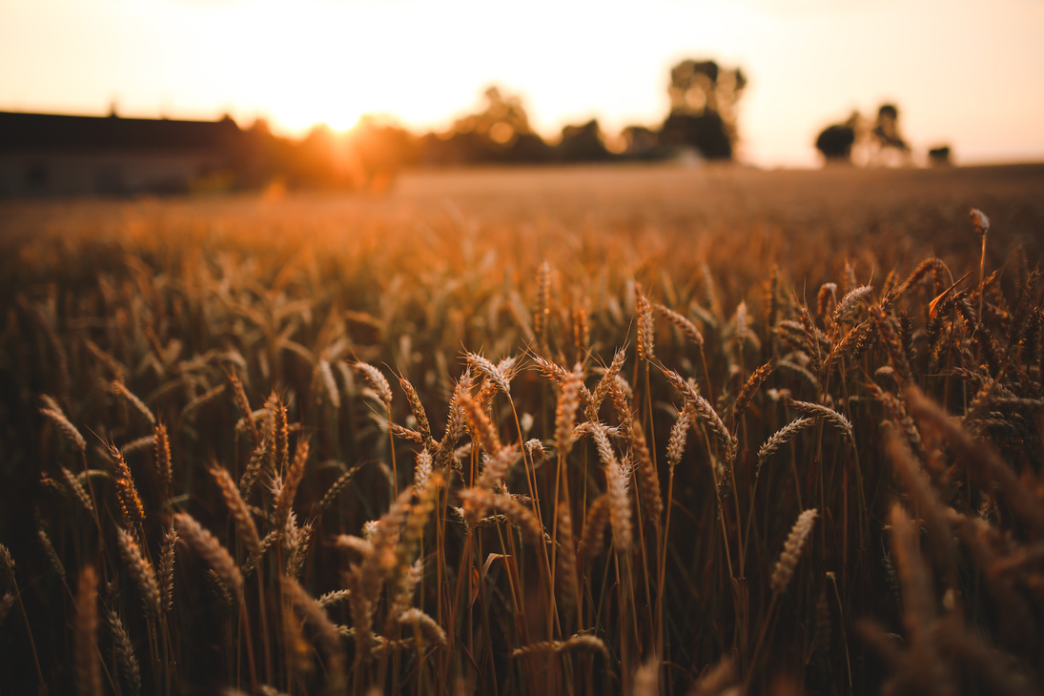
DISADVANTAGES
1
  High Computational Cost
SVMs can be computationally intensive, especially with large datasets. Training time increases significantly with the number of samples, making it less suitable for large-scale applications.
2
  Memory Consumption:
SVM requires storing and processing a large number of support vectors, which can lead to high memory usage, particularly for large datasets.

Slide 8
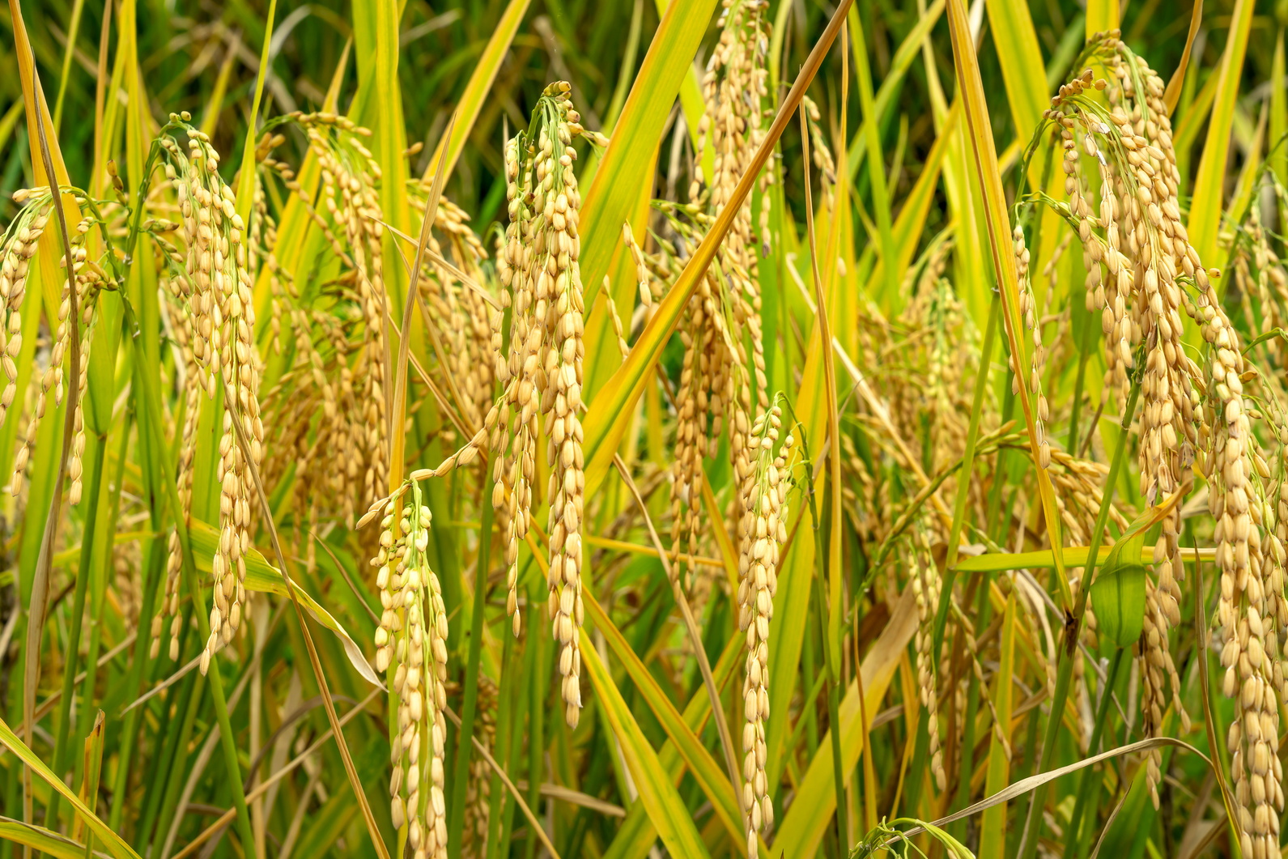
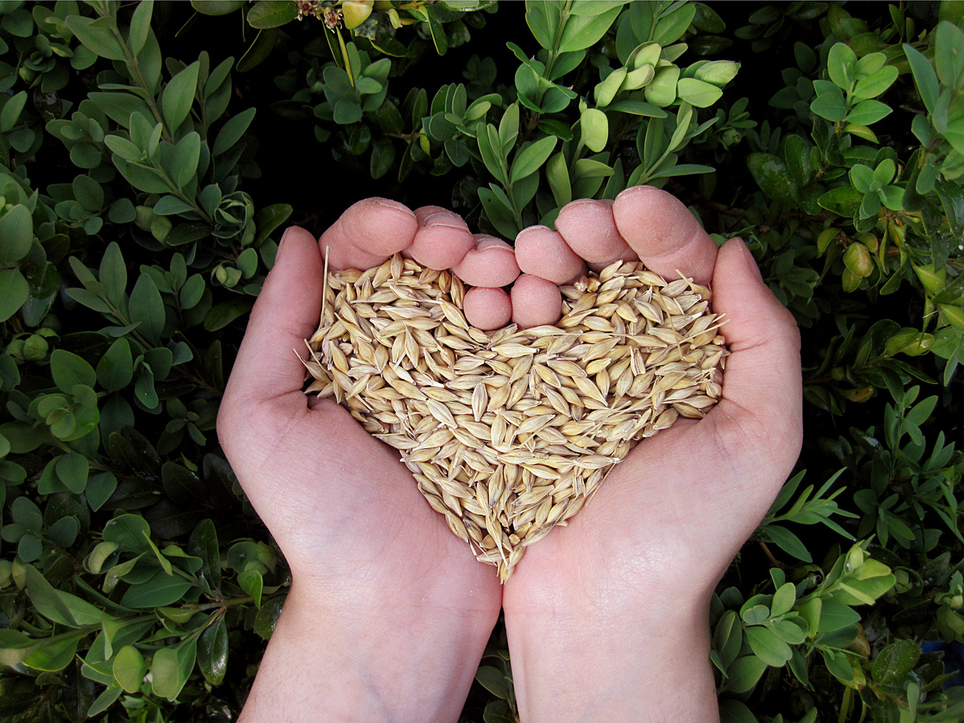
DISADVANTAGES
3
  Difficult to Interpret:
SVM models, particularly those with non-linear kernels, are often considered black-box models, making them difficult to interpret and understand, which can be a drawback when transparency is required.
4
  Limited Flexibility:
SVMs are less flexible in capturing complex patterns in data compared to some other machine learning models, such as neural networks, which might limit their effectiveness in complex, multi-dimensional problems like career recommendations.

Slide 9
PROPOSED
SYSTEM

Slide 10
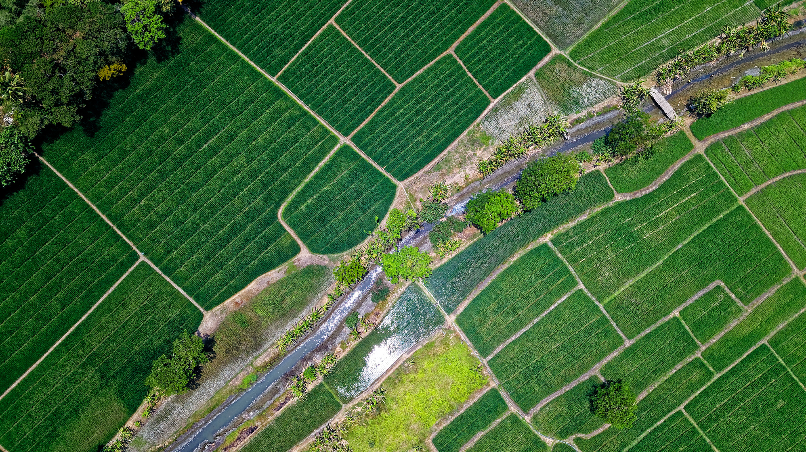
PROPOSED SYSTEM
  The proposed system is an AI-powered chatbot designed to assist farmers by offering personalized crop recommendations based on soil parameters and accurate plant disease prediction using image analysis.
  For crop recommendations, the system will utilize the XGBoost algorithm, known for its efficiency and high performance in handling structured data.
  XGBoost will analyze soil attributes such as pH, moisture content, and nutrient levels to recommend the best-suited crops for a farmer's land, ensuring optimal yields and sustainable farming practices.

Slide 11
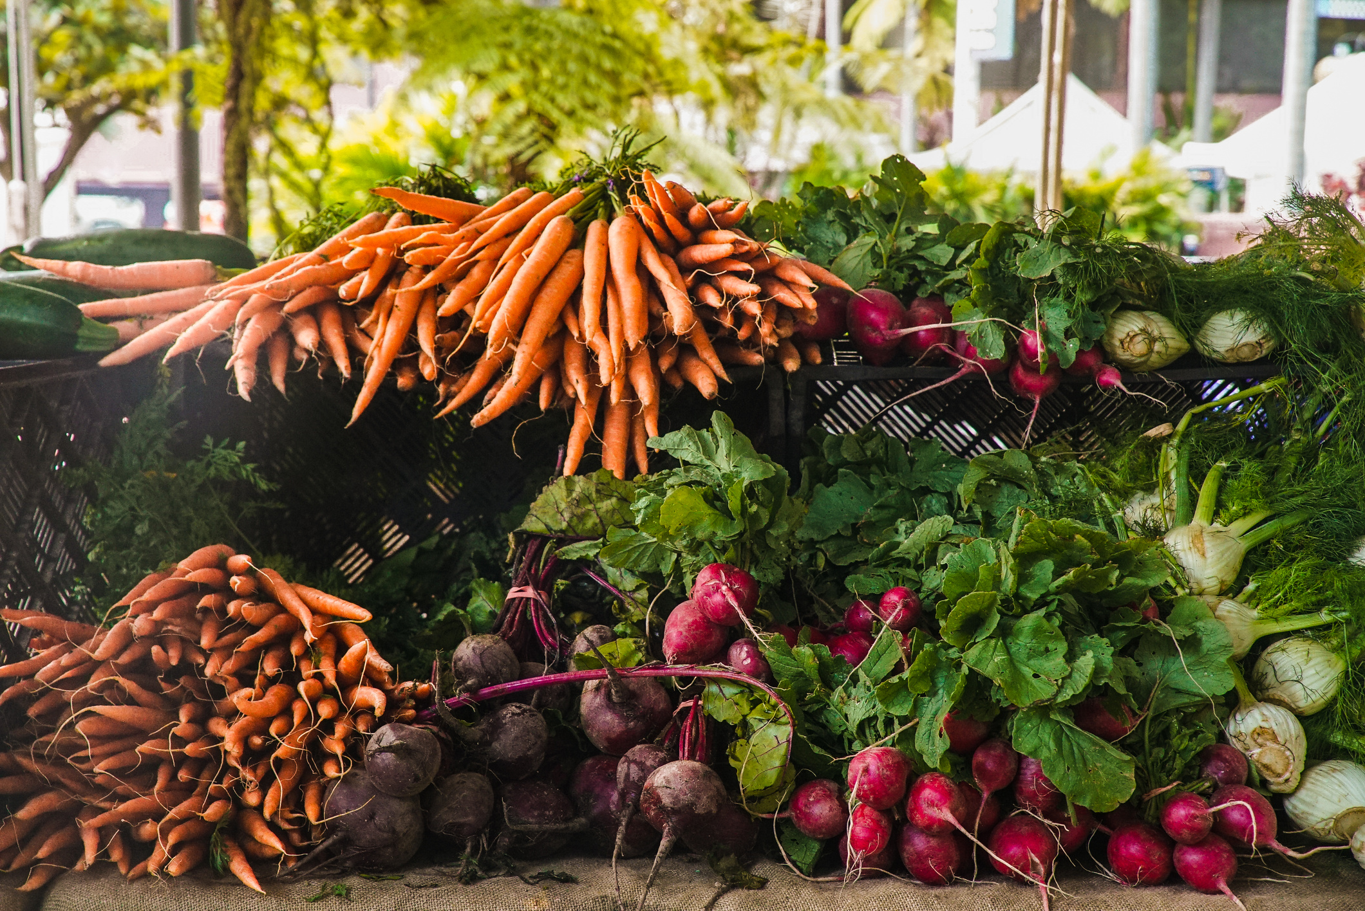
PROPOSED SYSTEM
  For plant disease prediction, the system will implement a ResNet (Residual Neural Network), a powerful deep learning model capable of classifying and identifying plant diseases from images with high precision.
  Farmers will be able to upload images of affected crops, and the ResNet-based model will detect and classify diseases, providing treatment suggestions.
  The combination of XGBoost for decision-making and ResNet for image-based disease detection ensures a robust, scalable system that improves productivity, reduces crop losses, and enhances overall agricultural efficiency.

Slide 12
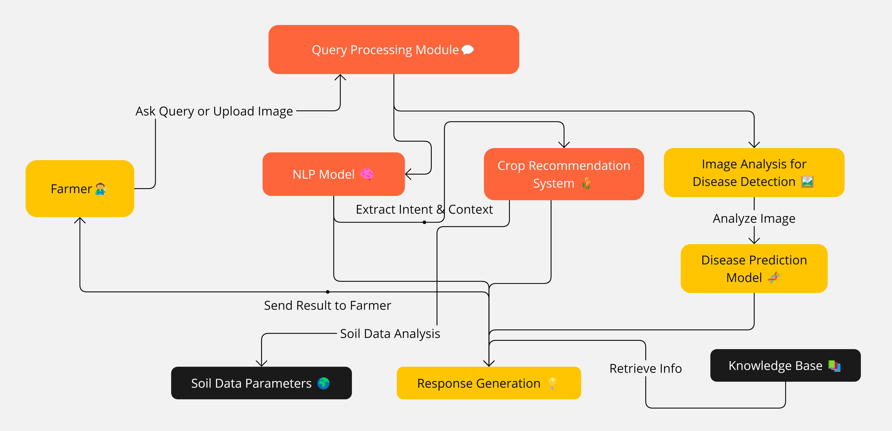
ARCHITECTURE

Slide 13
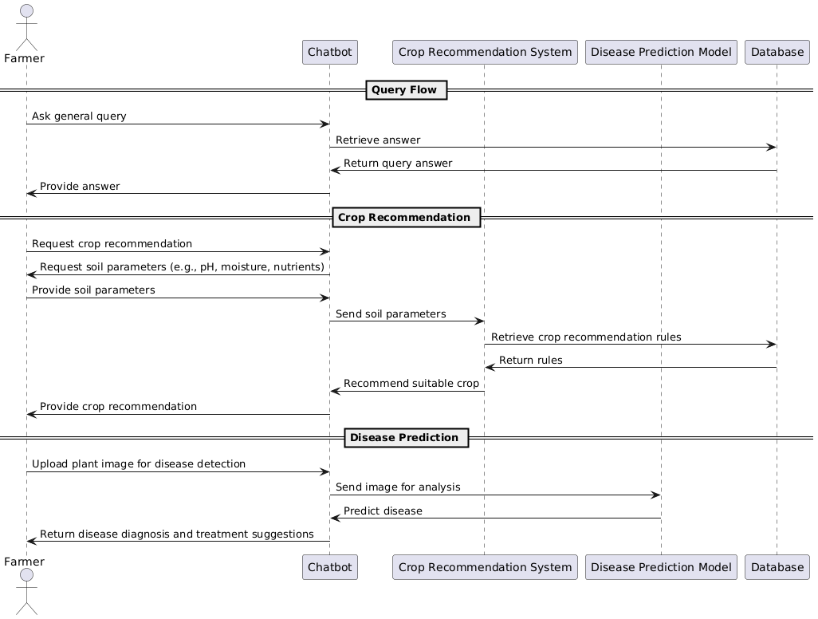
SEQUENCE DIAGRAM

Slide 14
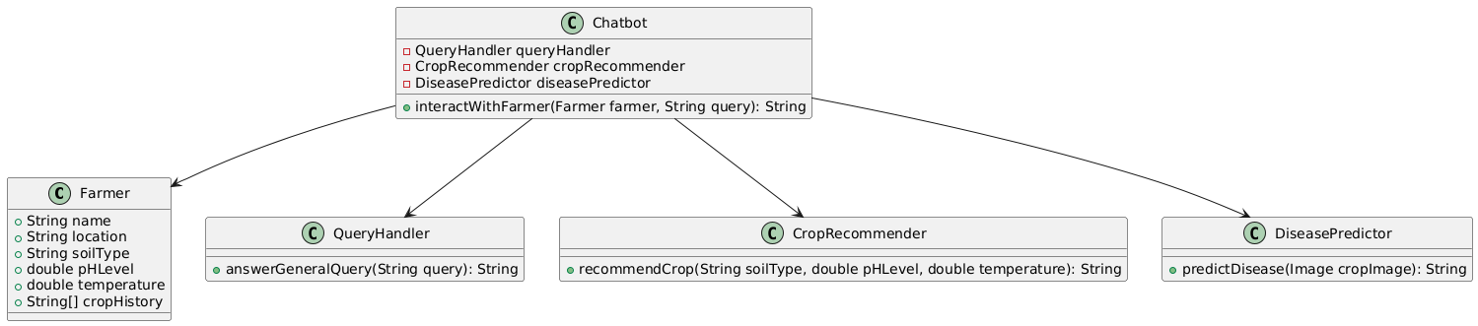
CLASS DIAGRAM

Slide 15
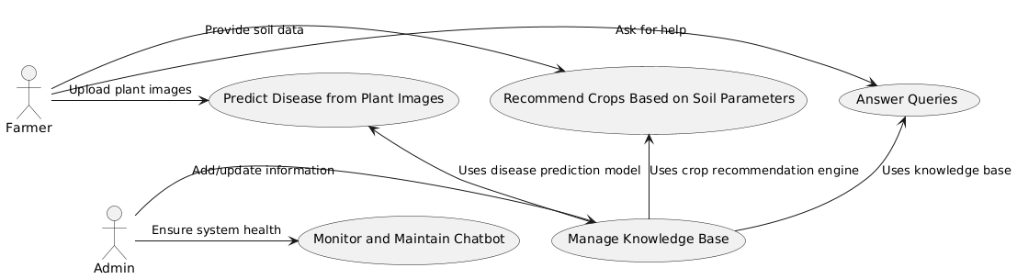
USE CASE DIAGRAM

Slide 16
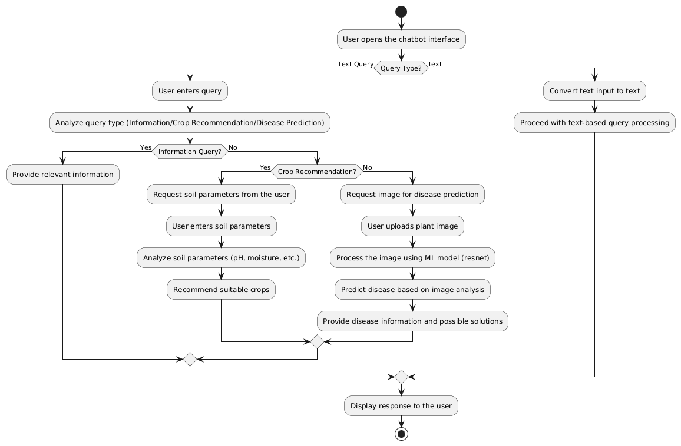
ACTIVITY DIAGRAM

Slide 17

ADVATAGES
  High Accuracy in Crop Recommendations: The use of the XGBoost algorithm ensures precise and reliable crop recommendations by analyzing various soil parameters, including pH, moisture, and nutrient content, leading to improved yields and optimized farming practices.
  Efficient Disease Prediction: With the implementation of the ResNet model, the system can accurately detect and classify plant diseases from images. ResNet’s deep learning architecture allows for high precision, reducing the risk of misdiagnosis and ensuring timely intervention.
  Real-Time Support for Farmers: The chatbot provides instant answers to farmers’ queries, offering real-time guidance on crop selection and disease management, which saves time and effort for farmers and reduces dependence on external experts.
97%
ACCURACY

Slide 18

01
02
03
04
DATA COLLECTION
CHATBOT
DEVELOPEMENT
MODEL TRAINING
TESTING & DEPLOYMENT:
MODULES
  Collect relevant soil data (pH, moisture, nutrient levels) and plant disease image datasets.
  Compile a dataset containing various crop types, their soil requirements, and corresponding optimal conditions.
  Gather image datasets of common crop diseases to train the ResNet model.
  Develop a chatbot using Natural Language Processing (NLP) to understand and respond to farmers' queries.
  Integrate the XGBoost model to provide real-time crop recommendations when farmers input soil parameters.
  XGBoost Model:
  Train the XGBoost model using soil data to classify and recommend suitable crops based on input parameters like pH, moisture, and nutrients.
  ResNet Model:
  Train the ResNet model on the disease image dataset to classify plant diseases based on visual characteristics.
  Deploy the chatbot as a web or mobile application accessible to farmers.
  Ensure real-time functionality for answering queries, crop recommendations, and disease detection.

Slide 19

HARDWARE
REQUIREMENTS
  System : Pentium i3 Processor.
  Hard Disk : 20 GB.
  Monitor : 15’’ LED
  Input Devices : Keyboard, Mouse
  Ram : 4 GB

Slide 20
SOFTWARE
REQUIREMENTS
  Operating system : Windows 10 Pro, MAC OS
  Coding Language : Python 3.10.9, HTML, CSS,JS
  Web Framework : Flask

Slide 21
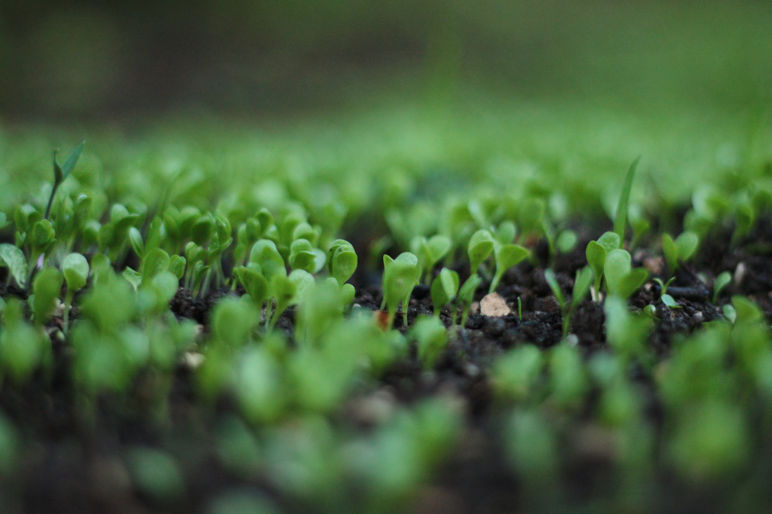

CONCLUSION
  The development of an AI-powered chatbot utilizing XGBoost for crop recommendations and ResNet for plant disease prediction represents a significant advancement in supporting farmers with data-driven, real-time insights.
  By integrating machine learning algorithms with a user-friendly interface, the system effectively addresses key agricultural challenges such as crop selection based on soil parameters and the early detection of plant diseases
  . The chatbot empowers farmers with personalized solutions, enabling them to make informed decisions that enhance productivity, reduce crop losses, and promote sustainable farming practices.

Slide 22
REFERENCE
[1] Venkata Reddy P S, Dr. Nandini Prasad K S, Dr. Puttamadappa C "SASI: Smart Agriculture System Based on IoT", European Journal of Molecular & Clinical Medicine, ISSN 2515-8260 Volume 07, Issue 08, 2020
[2] J. Vijayalakshmi, K. PandiMeena, “Agriculture TalkBot Using AI”, International Journal of Recent Technology and Engineering (IJRTE) ISSN: 2277 – 3878, Volume-8, Issue-2S5, July 2019.
[3] J. Bang, H. Noh, Y. Kim and G. G. Lee, "Example-based chat oriented dialogue system with personalized long-term memory", 2015 International Conference on Big Data and Smart Computing (BIGCOMP), Jeju, 2015.
[4] E. Haller and T. Rebedea, "Designing a Chat-bot that Simulates an Historical Figure," 2013 19th International Conference on Control Systems and Computer Science, Bucharest, 2013.
[5] P. Srivastava and N. Singh, "Automatized Medical Chatbot (Medibot)," 2020 International Conference on Power Electronics & IoT Applications in Renewable Energy and its Control (PARC), Mathura, India, 2020, pp. 351-354, doi: 10.1109/PARC49193.2020.236624.

